Slide 1
Category review: Chips
June 2020
Retail Analytics
Brand note: If client logo is not required, use alternate title page layout right click slide thumbnail > Layout > Title

Slide 2
Notes:
To view Privacy video explaining how important data privacy is to Quantium, please click here: https://www.youtube.com/watch?v=Zq1QDAkoRzU
or here Q:\Company Reference\Brand & Design\Brand videos\Q Privacy.mp4
At Quantium, we believe that data is the behavioural footprint of humanity and that it has to be treated with the utmost care and responsibility.
Histories, attitudes, indeed lives are stored within it in ways that aren’t always apparent – and that’s what makes its potential so powerful.
To work with it responsibly, sensitively, we set ourselves the highest data privacy protection and governance standards.
We have spent 17 years perfecting privacy-by-design and secure-by-design principles. Central to this is not holding any personally identifiable information about people –
we neither receive it, and put the necessary protections in place to be unable to decipher it.
Every aspect of handling data is safeguarded: from its de-identification, to its encryption – data security is paramount and of the highest grade.
We pride ourselves on gaining the trust of iconic organisations around the world through years of securely working with their data,
and in turn the trust that builds with their stakeholders.

Slide 3
Executive summary
1
Category
There was a spike in sales in December 2019.
175 g packets seem to be pulling most sales.
New Families form the smallest segment.
There was a huge sales drop in February 2019
2
Trial Store Performance
Store 77 and 86 went through a significant increase in Total Sales and the number of customers during the trial period as compared to their corresponding control stores.
Store 88 experienced an increase too. But it was insufficient as compared to its control store.

Slide 4
01
Category

Slide 5
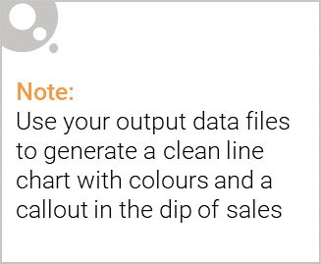
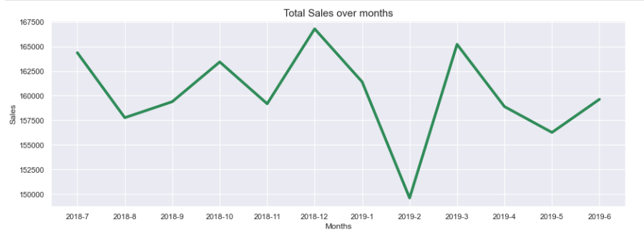
There was an increase in sales in December 2018 due to Christmas. The Sales dropped drastically after December 2018.

Slide 6

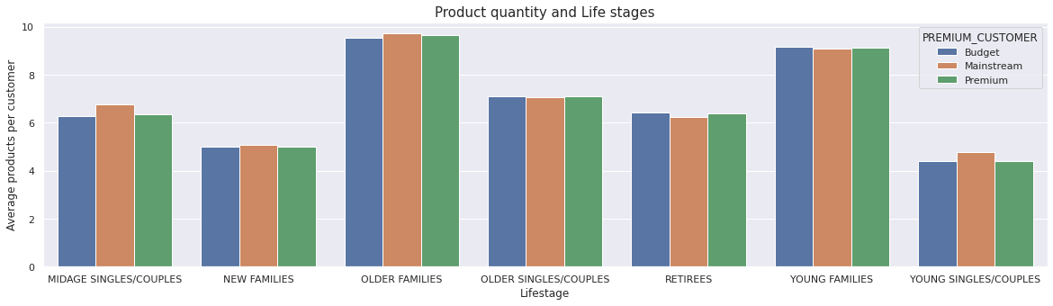
Young families and older families have the highest average products bought per unique customers.

Slide 7
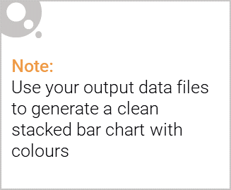
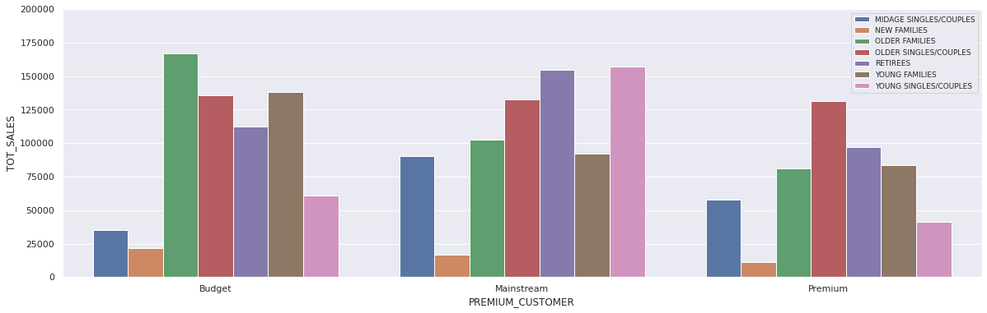
Editable (delete this)
Total Sales by Loyalty Card and Customer Life stages : Older Families, Retirees, Older Single/Couples and Mid age Singles/Couples make up most of the sales.
The young lifestage does not seem to be pulling significant sales as compared to the other life stages.

Slide 8
02
Trial store performance

Slide 9
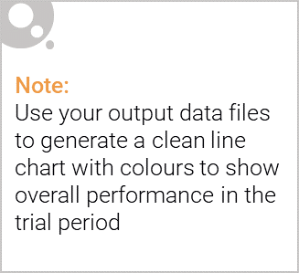
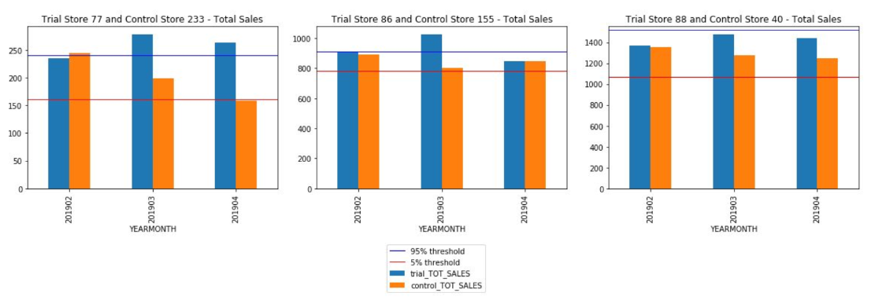
Trial stores 77 and March 2019 of 86 had significant increase in their sales than their control stores.
Trial store 88 also had a significant increase but it was not significant .

Slide 10
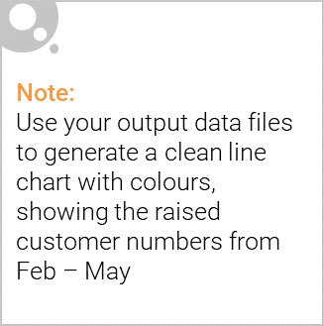
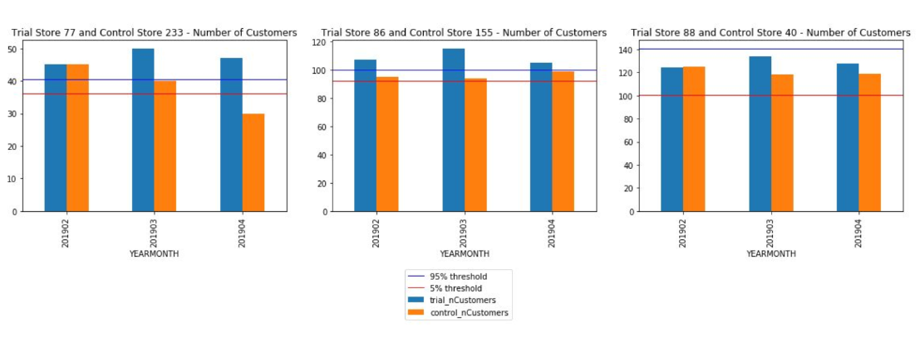
Trial stores 77 and 86 had significant increase in their customer counts than their control stores.
Trial store 88 also had a significant increase but it was not significant .

